Slide 1
Notes:
When you walk into a casino, what do you see? You’re taken back by the bright lights, the booming sounds, and you see the smiles on peoples faces. Everyone has one thing in mind when they walk into a casino, to win big and get rich. That’s not really what’s attractive to me about Las Vegas, because I know that the house always wins.

Slide 2
Notes:
My passion for hospitality didn’t start with casinos. I started by entering the culinary tech vocational program as a freshman (tigers loft). Since then, my love for the food industry amounted to nothing in my life.

Slide 3
Notes:
Since then, I have maintained various jobs in the trade. The first of those jobs being at sweetgreen in chestnuthill. Sweetgreen is essentially a chipotle for salads, serving 200-250 people in a lunch rush hour. This is where I developed a strong work ethic around high volume food service.

Slide 4
Notes:
Now, you can look at my job history and automatically think I want to become a chef or something. Contrary to the fact, I am pretty bored of being in the back of the house and feel my talents are being wasted. My goal, as egocentric as this sounds, is to be at the center of the industry.

Slide 5
Notes:
After working there for 7 months and working as a camp counselor over the summer, I returned for my junior year to work at La Morra, a fine dining italian restaurant in Brookline. I am currently employed here as a food runner and a busboy.

Slide 6
Notes:
This is where my internship at the marriott in auburndale comes into play. I will be apart of Marriott’s morning culinary prep team. I am definitely not excited to start work at 6am, but this will be my first exposure to the controlled chaos of the hotel industry.

Slide 7
Notes:
After I graduate in June, I will be moving to Las Vegas for the summer in order to establish my residency by working for UNLV catering and staying in an apartment on my own. This is going to be an amazing experience because I will be establishing connections at my university before I even start my freshman year.

Slide 8
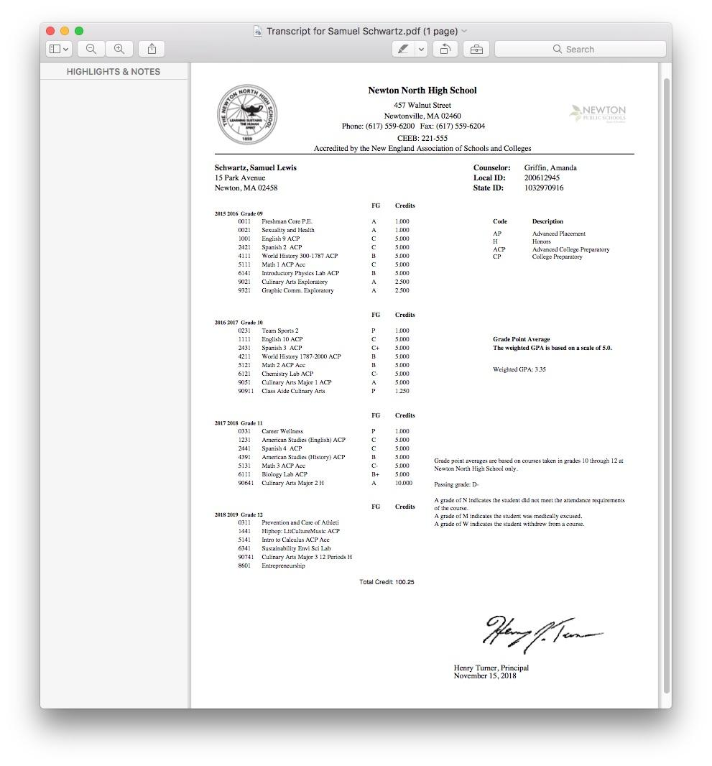
Notes:
This is my high school transcript. As you can see, doesn’t look like anything special. In fact by Newton North’s standards, this student is frowned upon. The public school system, especially highly regarded schools like newton north focus less on developemental growth and more on the competitveness and eventual success of getting into college.

Slide 9
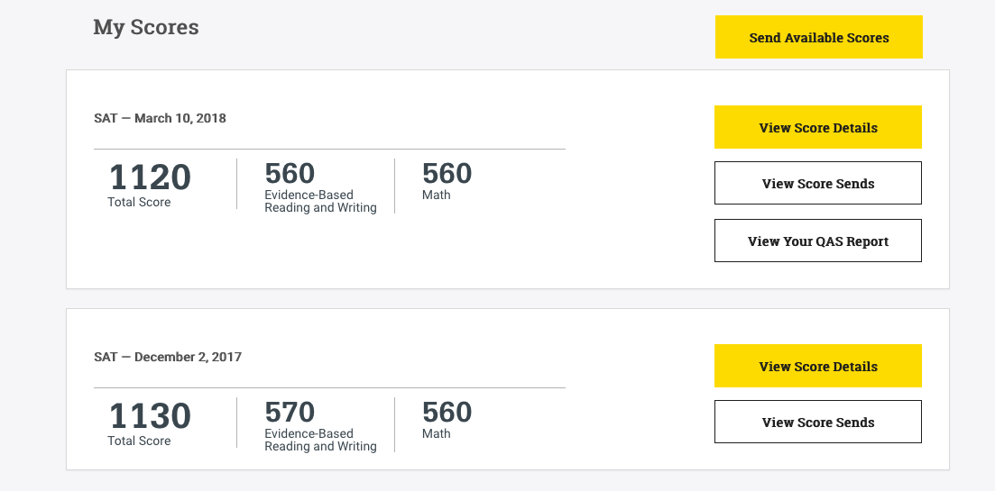
Notes:
And here we have my SAT scores. I wanted to put my grades on my pecha kucha because I think it is a really good example of how the infrastructure of public school is broken. When I send an application into college, all they see are my last two slides. A name, a GPA, and some test scores. But as I know and I believe as I have shown you in my pecha kucha, there is a lot more that meets the eye.

Slide 10
Notes:
This is why I believe capstone is the step in the right direction. The thing is people don’t know that there is kids like me out there, and if they do people usually let them fall between the cracks. I probably would have as well, but capstone was my safety net.

